Slide 1
CHiRP: Control-Flow History Reuse Prediction
Samira Mirbagher-Ajorpaz❈✦, Elba Garza❈, Gilles Pokam✢, and
Daniel A. Jiménez❈
❈Texas A&M University
✢Intel Labs
✦University of California – San Diego

Slide 2
Translation Lookaside Buffers (TLB)
TLBs lie on critical path to accessing memory
  On hit: Quick virtual-to-physical address translation
  On miss: Costly page table walk, multiple memory accesses
  (possibly 100’s of extra cycles!)
Limited in size (& reach) due to power, timing, area constraints
VPN
offset
Page Table
Walk(s)
TLB
Miss
Translation + 100s cycles
Hit
PPN
offset
Notes:
On a TLB hit, the processor benefits from a quick…
However, on a miss, the address translation must be looked up via the page table in a process called a page table walk, possibly requiring multiple memory accesses and computations.
Intel’s recent Sunny Cove core architecture, for example, has a five level radix page tabling structure.
As one can imagine, this look-up process is slow and time-consuming relative to processing speeds, incurring up to hundreds of extra cycles in penalty.
Because TLBs are on the critical path, they are limited in their size (and reach) due to timing, power, and area constraints.

Slide 3
Translation Lookaside Buffers (TLB)
New workloads (e.g. server) put tremendous stress on critical path to memory
TLB miss overhead: 5.5% to 19% of total execution time¹
Improved by L1 and L2 TLBs and MMU caches
⟹ Must make best use of small
size; keep only useful page
translations
¹Peng et al. 2006
Notes:
To make matters worse, newer compute workloads trend ever larger in code footprint and working set sizes, putting tremendous stress on the critical path to memory.
To lessen the page walk penalty, structures like hierarchical TLBs and special MMU caches have been proposed, but scaling the memory wall offers architects only so much.
Recent Intel architectures reveal L2 TLB miss penalties above 100 cycles each even with these mitigation techniques in place.
As such, TLBs must make the best use of their small sizes and maintain only useful page translations that are likely to be re-referenced.

Slide 4
Exploring Replacement Policy
Goal: Improve TLB performance without necessitating increased TLB sizes, or extending hierarchies
  Least-Recently-Used (LRU) replacement policy is ubiquitous for TLBs
  TLB access patterns similar to caches’, albeit at larger granularity
  TLBs are tagged, set-associative SRAM arrays, like caches…
  Apply prior predictive replacement policies!
Notes:
This inspires our goal of improving TLB performance…
We note that the Least Recent Used policy seems ubiquitous in TLBs but surprisingly find little else mentioned in the literature.
We also note that TLBs have access patterns similar to caches’ albeit at a larger granularity from 64B to 4KB for a page.
Also, TLBs are tagged..
<click> So why not apply prior predictive replacement policies?

Slide 5
Exploring Replacement Policy
Consider current TLB replacement policies & cache-based:
  LRU
  Random
  Static Re-reference Interval Prediction (SRRIP¹)
  Signature-Based Hit Prediction (SHiP²)
  Global History Reuse Prediction (GHRP³)
Focus on L2 TLB, accounts for most cycles in miss handler⁴
Benchmark
Problem: Not very effective for
TLB replacement!
LRU Random SRRIP SHiP GHRP
¹Jaleel et al. 2010 ²Wu et al. 2012 ³Mirbagher et al. 2018 ⁴Basu et al. 2013
Notes:
We consider the two current known TLB replacement policies, LRU and Random, and three cache-based policies.
We focus on the L2 TLB because it has been found to account for the most of the cycles spent in the TLB miss handler
<click> However we have a problem…
To the right is a heat map which shows hot and cold TLB entries for various benchmarks of interest among the replacement policies considered.
Darker colored entries denote TLB entries that are dead, or not re-referenced often. These entries should be kicked out to make way for more useful data.
Optimally, we wish a heat map to show light-colored entries signifying frequent entry re-referencing, a sign of a useful cache structure.
Surprisingly, even Random replacement maintains hotter entries in the TLB compared to an LRU policy.

Slide 6
Exploring Replacement Policy
Observations:
Replacement algorithm inaccuracies due to conflicts within sets, not among sets.
Coarse-grained nature of TLBs results in increased aliasing.
TLB reuse prediction does not benefit from large global histories. However, branch path history helps.
Benchmark
LRU Random SRRIP SHiP GHRP
These observations lead to...
Notes:
By applying these predictive replacement policies, we made the following observations.
First, the replacement algorithms’ inaccuracies were found to be due to intra-set conficts, not inter-set.
We find that a TLB entry may experience many hits from one or more PCs that map to the same entry before it is eventually evicted. This is because a larger range of unique addresses map to the same entry in the TLB compared to accesses to a block in a cache.
This follows to the second observation that the coarse-grained…
This causes the prediction counters of policies to saturate too quickly, rendering the predictors ineffective.
A good TLB replacement policy needs to be more selective in when to update prediction counters so as to avoid such oversaturation.
Third, while previous work has shown that longer PC histories alone benefit predictive replacement policies in the LLC and i-cache, this is not the case in the TLB.
However, branch path history does help. This is likely due to the fact that L2 TLB accesses come from both data and instructions in the first-level TLBs.
Conditional branch histories, in particular, can reflect the data accesses when the global path history may not.
<click> These observations lead to us proposing…

Slide 7
CHiRP: Control-Flow History Reuse Prediction
Indexes prediction table using a history signature specially designed to correlate with TLB behavior
Reduces L2 TLB misses by 28.21% over LRU with 1KB hardware overhead off the critical path
Yields geometric mean speedup of 4.8% over LRU
Benchmark
LRU Random SRRIP SHiP GHRP CHiRP

Slide 8
CHiRP: Signature Generation
Global Path PC History
⊕
Conditional Branch PC History
Signature is constructed by combining three control-flow histories with shifted current-time (t) PC:
  Global Path PC History
  Conditional Branch PC History
  Unconditional Branch PC History
Stored in associated TLB Entry
Used to index CHiRP prediction table
⊕
Unconditional Branch PC History
⊕
PC_{t} >> 2
New Signature
valid
Prediction
LRU stack
Signature
TLB Entry
Notes:
As we mentioned, CHiRP uses a specially designed history signature, made by combining three control-flow histories with current-time (t) PC.
Making the signature a combination rather than keeping all the histories as signatures reduces hardware storage and prediction time.
Note that we store PC value history, not outcome history. Specific-order bits from Branch and Path PCs are stored and then combined together to for the signature.
More information on signature generation, including which bits are used, shifted, and how they’re combined and stored can be found in the paper (and I do have supplemental slides on it)
For now, it’s sufficient to know that this signature is stored in its associated TLB entry, and is used to index the CHiRP prediction table. <click>

Slide 9
CHiRP: Data Maintenance
Prediction Table
Reuse Prediction also stored in TLB entry
Predictions computed by the previous access to table entry
Prediction computation not on critical path!
Signature
counter > threshold ? dead : alive
hash
⋯
valid
Prediction
LRU stack
Signature
Prediction
TLB Entry
Notes:
The reuse prediction for the entry is also stored within it.
This prediction is computed beforehand by the previous access to the entry.
The diagram to the right shows how a TLB entry’s signature leads to its own reuse prediction.
First, the signature <click> in the TLB entry is hashed <click> to index the CHiRP prediction table. <click>
Next, this indexed counter is thresholded, <click> and if found to be greater than the threshold, a prediction <click> that the entry “dead” is placed in its TLB entry. <click>
If the counter is less than the threshold, a prediction that the entry is “alive” is placed instead.
This stored prediction is “one ahead”. As in, the prediction stored is for the NEXT TIME the entry is accessed. This ensures the prediction computation is off the critical path.

Slide 10
CHiRP: Prediction Updates
LRU Victim TLB Entry
Hit TLB Entry
valid
Prediction
LRU stack
Signature
On TLB hit:
  Use hit entry signature to index prediction table
  Decrement counter value to keep it below threshold & “alive”
On TLB miss:
  Select LRU victim from TLB
  Use victim signature to access prediction table
  Increment counter value—eventually will be above threshold & predicted dead
++
−−
Hit!
Access to set which is different from the last accessed set
Miss!
Miss in a set with no dead entries
Notes:
CHiRP only accesses the prediction table during two events. Remember, due to high granularity, limited counter modification is necessary to ensure that oversaturation is avoided.
One event is on a hit to a TLB set that is different from the one accessed last. <click>
We call this policy Selective Hit Update, and helps reduce the number of table accesses, minimizes counter saturation, and alone helps reduce average MPKI (or misses per 1000 instructions) by 5.85%.
A bit to track this “first hit” is kept for each TLB entry, but isn’t shown here. <click>
We use the hit TLB entry’s signature to index the table . <click> <click> and decrement the corresponding 2-bit counter <click>
<click>
The other event is on a TLB miss where there are no predicted-dead entries in the set. <click> Thus, we select the victim by LRU policy. <click>
We use this victim’s signature to index the table and increment the counter value. <click>

Slide 11
CHIRP: Hardware Overhead
Structure | Component(s) | Bits | Num Entries | Total (B)
Modified L2 TLB (4 KB page sizes) | Prediction Bits | 1 | 1024 | 128
 | FirstHit Bits | 1 | 1024 | 128
 | LRU Position Bits | 3 | 1024 | 384
 | Signature Bits | 16 | 1024 | 2048
CHiRP Prediction Table | Saturating Counters | 2 | 512 to 2048 | 128 to 8192
CHiRP Miscellaneous Registers | Path History Register | 64 | 1 | 8
 | Conditional History Register | 64 | 1 | 8
 | Unconditional History Register | 64 | 1 | 8
 |  |  | Total (B): | 2840 to 10904
 |  |  | Total (KB): | 2.773 to 10.648
Notes:
The hardware overhead for CHiRP is quite small, on the order of Kilobytes, depending on the chosen prediction table size.
The structures are the modified L2 TLB and CHiRP’s prediction table and miscellaneous history registers.
CHiRP does require modification to the L2 TLB to store metadata, but so would any prediction scheme, including LRU.

Slide 12
Methodology
Extended simulator for the recent Championship Value Prediction Competition (CVP-1)
Tested 870 industry-sourced long & short traces for CVP-1
  SPEC
  Database
  Crypto
  Scientific
  Web
  “Big Data”
Short traces simulated to completion; long traces to 100 million instructions
Measure misses per 1000 instructions (MPKI) & instructions per cycle (IPC)
Replacement policies modeled:
  LRU
  Random
  SRRIP
  SHIP
  GHRP
  CHiRP
Notes:
Our methodology had us extend the simulating infrastructure used in the recent Championship Value Prediction Competition, or CVP-1.
To avoid overfitting, we tested our replacement policies on over 870 industry-sourced long and short traces offered for CVP-1.
The types of workloads vary greatly and include the tired and true SPEC, to database traces, and “big data”

Slide 13
Methodology
Processor Component | Parameters | Latencies (& Penalties)
L1 Instruction Cache | 64 KB, 8 way | 4 cycles
L1 Data Cache | 64 KB, 8 way | 4 cycles
L2 Unified Cache | 256 KB, 16 way | 12 cycles
L3 Unified Cache | 8 MB, 16 way | 42 cycles
DRAM |  | 240 cycles
Branch Predictor | Hashed Perceptron 4K entry BTB | 20 cycle miss penalty
L1 Instruction TLB | 64 entry, 8 way | 1 cycle
L1 Data TLB | 64 entry, 8 way | 1 cycle
L2 Unified TLB | 1024 entry, 8 way | 8 cycle hit latency 20 to 360 cycle miss penalty
Notes:
The hardware configuration simulated is shown in this table.
Most of interest is the CHiRP-ified L2 Unified TLB, where we varied the TLB miss penalty from between 20 to 360 cycles.

Slide 14
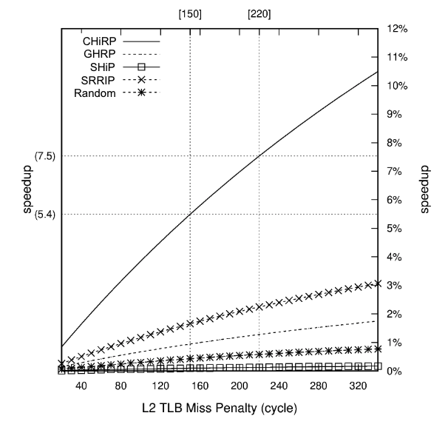
Speedup vs. Miss Penalty
As L2 TLB miss penalty increases, predictive policies’ advantage grows
CHiRP speedup of >10% for latencies greater than 320 cycles
Other policies “flatten out” to a max of 3% speedup
Notes:
The left-hand plot shows the speedup results (over LRU) for these varied L2 TLB miss penalties.
Note that as the L2 TLB miss penalty increases, so do the speedups offered by predictive policies.
CHiRP’s speedup value increase fastest, <click> and surpasses 10% for latencies greater than 320 cycles, not out of the realm of possibility given computing workload trends!
Other policies, however, flatten out to a max speedup of 3% by the 320 cycle mark.

Slide 15
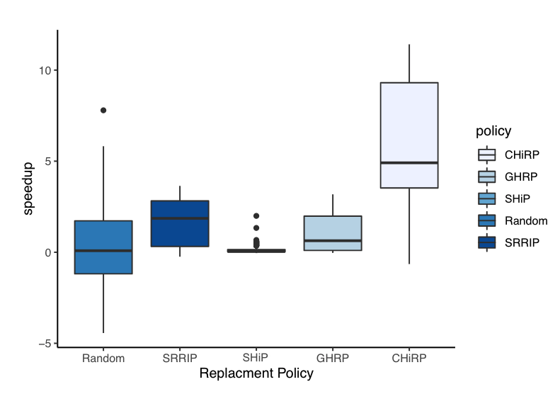
Speedup Results
Speedup at:
  150-cycle TLB miss penalty
Random outperforms LRU!
SHiP & GHRP suffer due to latencies from multiple accesses to its prediction tables
0.42%
1.65%
0.13%
0.94%
4.80%
Notes:
From this plot, only assuming a 150 cycle miss penalty, we generate the box and whisker plot on the right.
Note how random outperforms LRU overall, <click> if only a little at 0.42%
<3 clicks> SHiP and GHRP do little better than LRU at 0.13% and 0.94% respectively. This is likely due to the latencies incurred from their multiple accesses to their prediction tables.
CHiRP outperforms them all at 4.8% speedup.

Slide 16
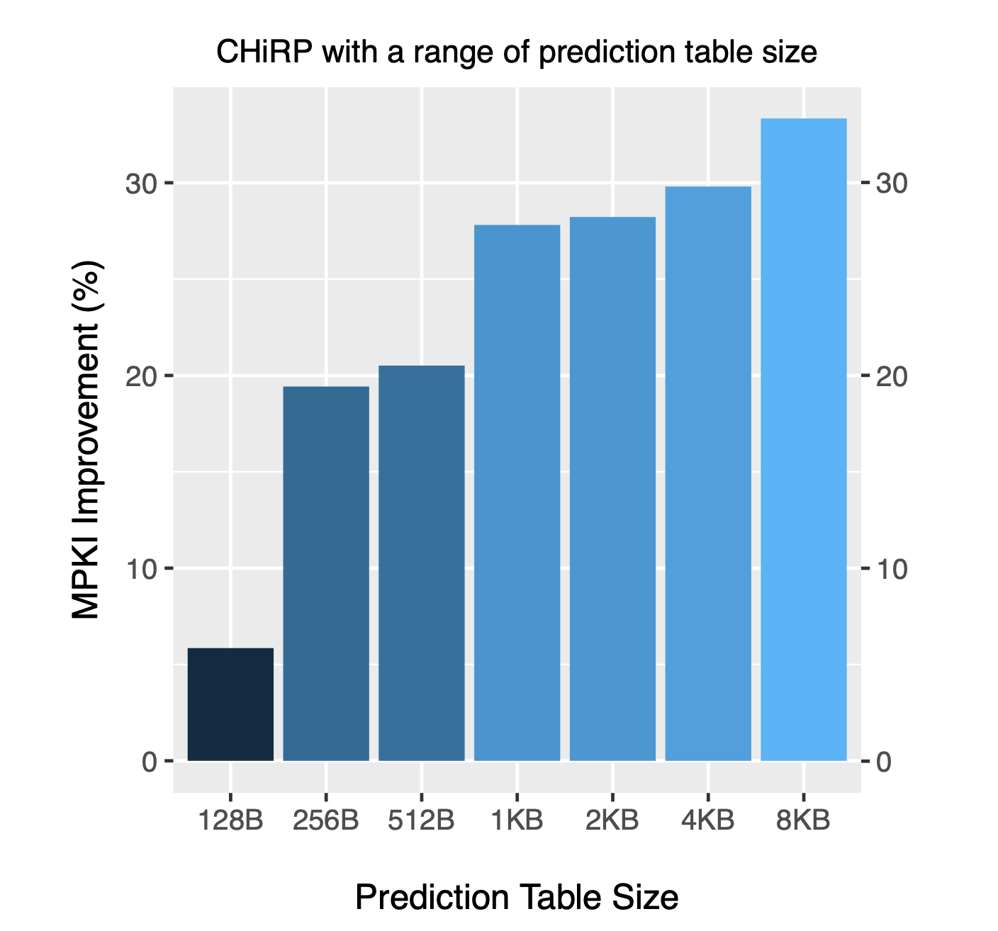
Complexity & Hardware
Prediction Table Sizing
Reduced prediction table sizes still offer MPKI improvements
Improvement over LRU:
  128B table ⟹ 7% MPKI
  1KB table ⟹ 28% MPKI
6% TLB overhead at 1KB
CHiRP is more complex than LRU—still lightweight due to timing constraints
Notes:
Even with reduced prediction table sizes, CHiRP still offer MPKI improvements.
At just a 128B prediction table, CHiRP improves MPKI by 7%, much more than any of the other policies at full size.
In our configurations based on industry sources, CHiRP comprises a 6% TLB overhead with a 1KB prediction table.
While CHiRP is more complex than LRU, it still is lightweight because it HAS to be, due to timing constraints.

Slide 17
Future Work
Large pages (e.g. 2 MB, 4MB, even 1GB) increasingly being supported—theoretically reduce capacity misses
Extend CHiRP to variable-size pages—opens up a can of worms…
Ex: Have two TLB entries that map 4KB and 2MB; which to keep in TLB? Not so simple!
⟹ Exciting research possibilities!
Other practical issues: memory fragmentation, TLB partitioning choices, etc.
Notes:
In this work, we focused on the more common 4KB page, but we would like to support variable sizing.
We have to account for the cost of moving large pages to and from memory.
We have to consider whether a 4 KB page may suffice or of it’s getting re-referenced more often.

Slide 18
Conclusion
Investigate replacement policy within TLBs
Previous predictive policies are not plug-and-play!
Introduce CHiRP: indexes prediction table using a history signature specially designed to correlate with TLB behavior
Reduces L2 TLB misses by 28.21% over LRU with 1KB hardware overhead off the critical path
Yields geometric mean speedup of 4.8% over LRU
Notes:
In conclusion, this work investigated the effect of replacement policy with TLBs
We show how previous predictive policies for other caching structures are not plug-and-play for the TLB

Slide 19
Extra slides

Slide 20
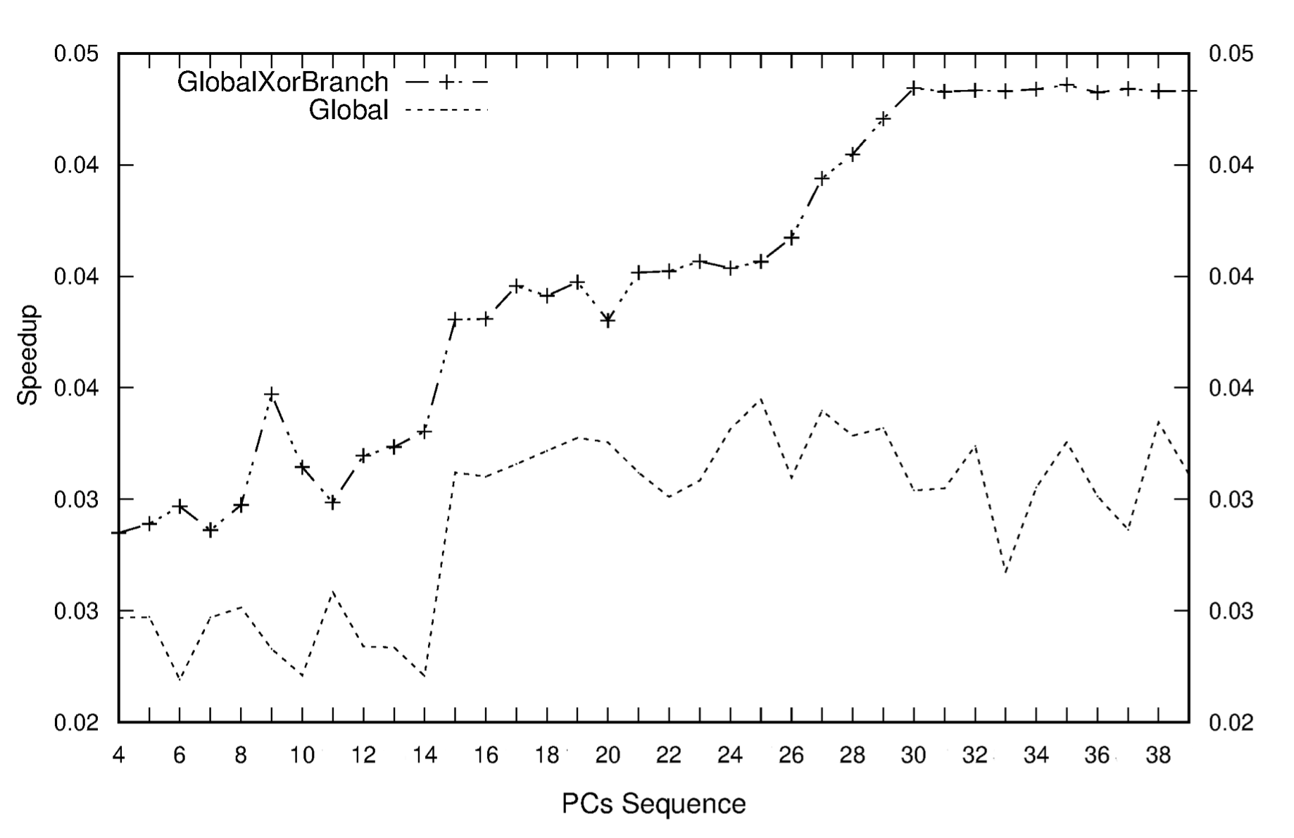
Global PC History vs. Speedup
Notes:
Speedup does not increase for global PC history length more than 15. However, by combining branch history into the signature, CHiRP can benefit from history lengths longer than 30.

Slide 21
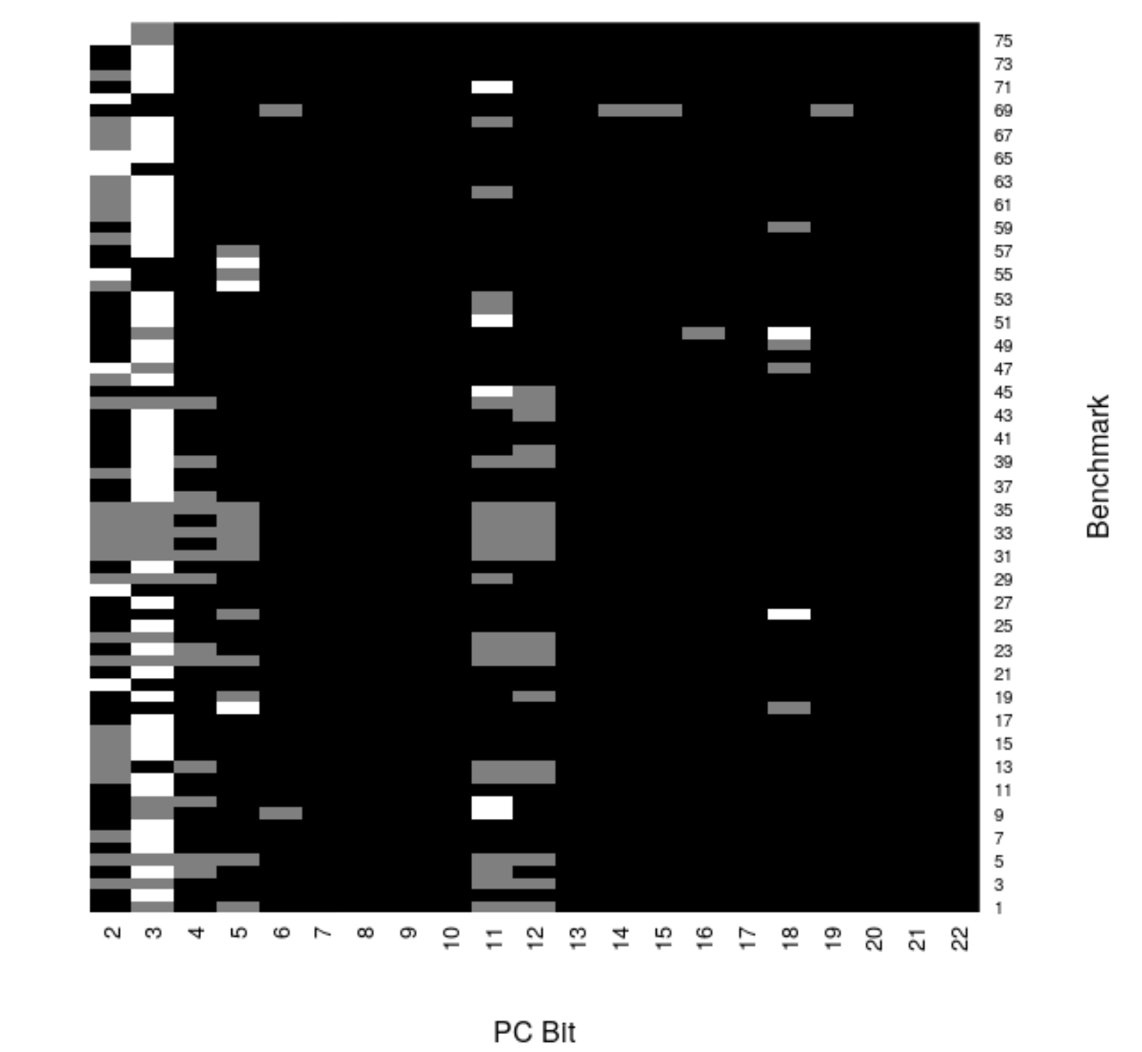
PC Bits Carry Uneven Weight
Notes:
Figure shows that the two lower-order bits of a PC address (bits 2 and 3) contain important information, as indicated by their higher-weight (lighter-color) values.

